Slide 1

Deepfake Detection for Identifying Machine-generated Tweets Using NLP And DL
by
Y Harshavardhan
Roll No. 224G5A3206
A Nadeem
Roll No. 214G1A3257
E Madhuri
Roll No. 214G1A3250
D Charan Kumar
Roll No. 214G1A3212
Under the guidance of
Ms. G. Shabana _{M. Tech.}
Assistant Professor
Department of Computer Science and Engineering (Data Science)
Srinivasa Ramanujan Institute of Technology
(Affiliated to JNTUA & Approved by AICTE) (Accredited by NAAC with ‘A’ Grade & Accredited by NBA (EEE, ECE & CSE)
Rotarypuram Village, B K Samudram Mandal, Ananthapuramu – 515701.
2024 - 2025

Slide 2

Contents
Abstract
Problem Statement
Objectives
Literature Survey
Proposed Work
Introduction
Existing System

Slide 3
Contents
Proposed System
Requirements
Data Preprocessing Techniques
References
Github Link

Slide 4
Abstract
Recent advancements in natural language generation have provided powerful tools capable of manipulating public opinion on social media platforms. Text-generative models now help people to create realistic deepfake posts using bots, influencing public conversations. This research focuses on detecting machine-generated text, specifically on platforms like Twitter. To achieve this goal, we propose a deep learning-based approach using a Convolutional Neural Network (CNN) architecture combined with FastText word embeddings to classify tweets as either human-generated or bot-generated. The proposed method was compared against several reports of baseline machine learning models. These baselines incorporated features such as Term Frequency (TF), Term Frequency-Inverse Document Frequency (TF-IDF), FastText, and FastText subword embeddings. The results of the study demonstrated the superior performance of the proposed CNN model with FastText embeddings, highlighting its capability to accurately detect deepfake tweets. This research highlights the value of deep learning and advanced embeddings in addressing the rising problem of machine-generated content, contributing to tools that help protect public discourse and combat misinformation online and ensuring the integrity of online interactions.

Slide 5
Problem Statement
With the increasing prevalence of natural language generation tools capable of creating realistic machine-generated text, there is a growing threat to the integrity of public discourse on social media platforms. This includes the rise of deepfake posts generated by bots to manipulate opinions and spread misinformation. Detecting and classifying such machine-generated content remains a critical challenge. This project aims to develop an effective deep learning-based solution using a Convolutional Neural Network (CNN) architecture combined with FastText embeddings to accurately classify tweets as human-generated or bot-generated, thereby contributing to the fight against online misinformation and safeguarding public discussions.

Slide 6
Objectives
Develop an Effective Detection Model: Design and implement a CNN-based deep learning approach combined with FastText embeddings to classify tweets as human-generated or bot-generated.
Evaluate and Optimize Performance: Compare the proposed model with baseline machine learning techniques, optimize its architecture, and demonstrate superior accuracy in detecting machine-generated text.
Safeguard Online Integrity: Contribute to combating misinformation and ensuring the integrity of public discourse by providing reliable tools to detect and mitigate the impact of deepfake tweets.

Slide 7
Literature Survey
No | Title | Author | Journal Name & Year | Methodology Adapted | Key Findings | Gaps
1. | Tweepfake: About detecting deepfake tweets | Tiziano Fagni, Fabrizio Falchi, Margherita Gambini, et al. | PLOS One, 2021 | Applied machine learning models (e.g., BERT) to classify AI-generated tweets. | High accuracy in detecting fake tweets, highlighting model potential. | Dataset bias due to limited diversity in tweet samples.
2. | ChatGPT or human? Detect and explain | Sandra Mitrović, Davide Andreoletti, Omran Ayoub | arXiv preprint, 2023 | Explored linguistic and stylistic patterns using transformer-based models for distinguishing ChatGPT-generated text from human text. | Effective in explaining why specific outputs are machine-generated. | Performance is model-dependent and lacks robustness to fine-tuned generative models.

Slide 8
Literature Survey
No | Title | Author | Journal Name & Year | Methodology Adapted | Key Findings | Gaps
3. | Deepfake tweets classification using stacked Bi-LSTM and words embedding | R Vaibhav, R Furqan, A Aashir, PB Washington, Ernesto Lee, A Imran | PeerJ Comput. Sci 7:e745, 2021 | Utilized stacked Bi-LSTM architecture with word embeddings for generating contextually accurate deepfake tweets. | The model produced human-like tweets with low perplexity and enhanced diversity in generated content. | The approach struggles with sarcasm, ambiguity, ethical misuse concerns, and computational inefficiency compared to other models.
4. | Deepfake detection using deep learning methods: A systematic and comprehensive review | A. Heidari, N. Jafari Navimipour, H. Dag, M. Unal | WIREs Data Mining and Knowledge Discovery, vol. 14, no. 2, pp. e1520, 2024 | Systematic review of deep learning-based deepfake detection approaches across various domains. | Highlighted effectiveness of CNNs, GANs, and transformers for multimedia deepfake detection. | Lacks a unified framework for practical implementation of detection methods.

Slide 9
Proposed Work
Data Collection and Preprocessing:
A labeled dataset containing tweets from human and bot accounts is sourced from the TweepFake dataset, which consists of:
25,572 tweets classified into human and bot-generated content:
Humans: 17 accounts, 12,786 tweets.
GPT-2: 11 accounts, 3,861 tweets.
RNN: 7 accounts, 4,181 tweets.
Other Bots: 5 accounts, 4,876 tweets.
The dataset is split into 80:20 ratios for training and testing.

Slide 10
Proposed Work contd..
Text Vectorization Using FastText Word Embedding:
Unlike traditional word embeddings (e.g., Word2Vec) that treat each word as a single unit, FastText represents words as a composition of subword n-grams.
A sentence "Deepfake detection is critical" becomes tokens [Deepfake, detection, is, critical]
Each token is broken down into overlapping character n-grams (e.g., "crit" and "ical" from "critical")
The embeddings of all subwords in a word are combined (e.g., averaged or summed) to create the final vector for the word.
After each word in a sentence is vectorized, the embeddings are aggregated to form the final sentence-level representation.

Slide 11
Proposed Work contd..
CNN Model Architecture:
Input Layer: The vectorized tweets obtained using FastText word embedding.
Convolutional Layers: Three layers are used. Outputs from these layers represent the patterns or relationships learned by the CNN.
Activation Function: ReLU is used to introduce non-linearity.
Pooling Layers: Max pooling is applied to prevent over fitting.
Flattening: The final pooled feature maps are flattened into a 1D vector.
Fully Connected Layer: Combines features, learns the optimal boundaries.
Output Layer: Produce probabilities for each class (e.g., human vs. bot-generated).

Slide 12
Proposed Work contd..
Model Training and Evaluation:
The CNN model is trained using the processed and vectorized data.
Evaluation metrics are used to measure model performance, which include:
Accuracy
Precision
Recall
F1-Score

Slide 13
Introduction
Overview of Social Media Challenges: Social media connects people but has also become a platform for misinformation, spread using bots and deepfake content like AI-generated text, audio, and videos.
Emergence of Deepfake Texts: Deepfake, combining "deep learning" and "fake," refers to deceptive AI-generated multimedia, raising concerns about its misuse in politics and public opinion.
Role of Generative Models: Advanced models like GPT-2 and GPT-3 make it difficult to differentiate human-written from machine-generated content, especially in short texts like tweets.
Research Gap and Dataset: While deepfake detection in long text is studied, detecting bot-generated tweets is less explored. The Tweepfake dataset provides human and bot-generated tweets for this study.
The Approach: This project uses a CNN with FastText embeddings to reliably classify tweets as human- or bot-generated, addressing the deepfake detection challenge.

Slide 14
Existing System
Existing research in deepfake text detection primarily utilizes graph-based and feature-based machine learning approaches, providing insights into the creation and detection of deepfakes. However, these methods focus on longer texts like news stories, raising concerns about their applicability to shorter social media texts. The existing system uses a stacked Bi-LSTM architecture with word embeddings to generate realistic deepfake tweets by capturing contextual relationships and semantic meanings. While effective in producing coherent tweets, it struggles with nuanced patterns like sarcasm or ambiguity, requires high computational resources, and lacks scalability for real-time applications.
Disadvantages:
Inability to handle sarcasm and ambiguous tweets effectively.
Poor adaptability to linguistic diversity and cultural variations.
Computational inefficiency, requiring high resources for training and inference.
Limited capability in detecting and analyzing machine-generated tweets.
Scalability issues, making it unsuitable for large-scale or real-time implementations.

Slide 15
Proposed System
The proposed system leverages deep learning models with FastText embeddings for identifying machine-generated tweets on social media. FastText embeddings capture subword-level information, improving handling of sarcasm, ambiguity, and rare words while ensuring adaptability to diverse linguistic contexts. Optimized architectures enhance computational efficiency and scalability, making the system suitable for real-time analysis. This approach combines robust feature extraction with advanced deep learning techniques, addressing the limitations of the existing system.
Advantages:
Sarcasm and Ambiguity: FastText’s subword-level representation improves handling of language patterns.
Linguistic Diversity: Adaptability to various languages and cultural contexts through FastText embeddings.
Computational Efficiency: Reduced resource consumption due to optimized deep learning models.
Detection Capability: Focused design on identifying machine-generated tweets enhances accuracy.
Scalability: Improved scalability for large-scale and real-time applications through efficient architectures.

Slide 16
Requirements
Functional | Non-Functional
Sarcasm and Ambiguity Linguistic Diversity Computational Efficiency Detection Capability Predicting | Performance Scalability Reliability Security Maintainability

Slide 17
Data Preprocessing Techniques
Tokenization: Split the text into individual words or tokens (e.g., "The cat sat" becomes ["the", "cat", "sat"]), For FastText, tokens are used to create word embeddings.
Subword Processing (Specific to FastText): Break down words into subwords or n-grams (e.g., "running" might be represented as ["run", "unn", "nni", "ing"]) to handle rare and unseen words.
Stemming and Lemmatization:
Stemming: Reduce words to their root form (e.g., "running" → "run").
Lemmatization: Map words to their base or dictionary form, considering context (e.g., "better" → "good").

Slide 18
Data Preprocessing Techniques
Vectorization :
TF/TF-IDF Vectorization: Convert text into numerical feature vectors based on word frequency (for baseline models).
FastText Embeddings: Generate dense numerical vectors for words or subwords using the FastText library.
Encoding Labels: Encode tweet labels (e.g., "human-generated" or "bot-generated") into numerical values (e.g., 0 and 1) for binary classification.
Batch Processing: Divide the dataset into mini-batches for efficient training and evaluation in the CNN model.

Slide 19
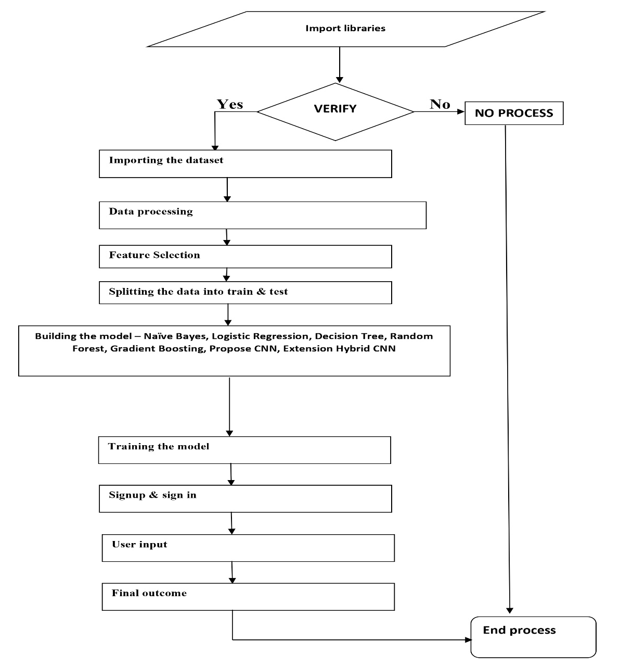
Implementation
Flow Diagram

Slide 20
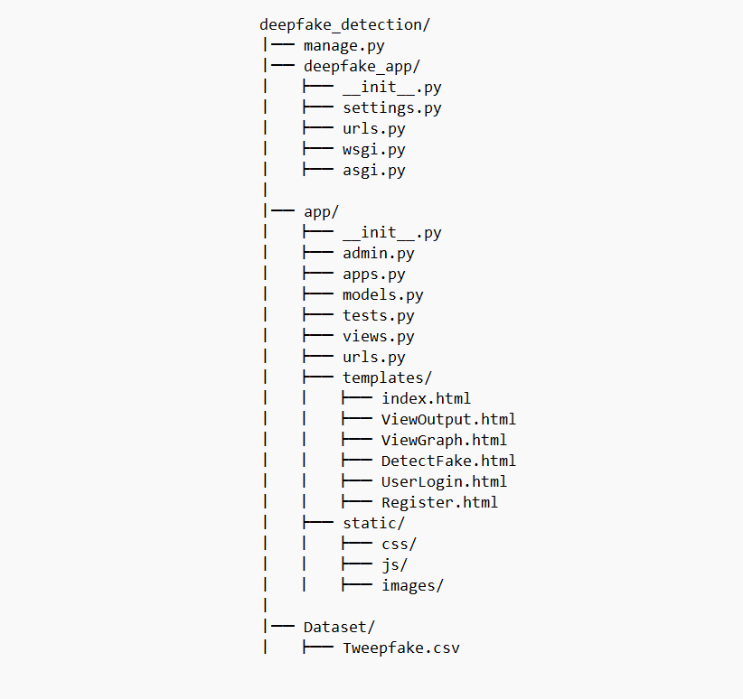
Implementation
File Structure

Slide 21
Implementation
1. Data Preprocessing
The dataset Tweepfake.csv is loaded from Dataset/ and preprocessed by:
Removing punctuation, special characters, and stop words.
Converting text data into numerical vectors using TF-IDF etc.
2. Machine Learning Model Training
Multiple ML models are trained for comparison.
Performance Metrics (Accuracy, Precision, Recall, F1-Score) are computed.
3. CNN Model for Deep Learning-Based Classification
The vectorized data is reshaped into a 3D format and passed into a CNN model.
If no pre-trained weights exist, the model is trained and saved.
Otherwise, pre-trained weights are loaded from model/cnn_weights.hdf5.

Slide 22
Implementation
4. Hybrid CNN + Random Forest Model
The CNN model's second-last layer is used to extract deep features and used to train the Classifier to improve detection performance.
5. Web Interface & Django Views
index() → Renders the homepage.
UserLogin() & Register() → Handles user authentication.
LoadDataset() → Displays sample tweets from the dataset.
TrainML() → Trains and evaluates models, generating a comparison graph.
DetectFake() & DetectFakeAction() → Accepts user input tweets and predicts whether they are fake or real.
6. Deepfake Detection
User submits a tweet.
The tweet is preprocessed and converted using TF-IDF.
The trained CNN model predicts if the tweet is from a bot or a real user.
The result is displayed to the user.

Slide 23

Project Output
Fast Text Embeddings

Slide 24

Project Output
Test case of Deepfake

Slide 25

Project Output
Test case Result 1

Slide 26

Project Output
Test case of Normal Tweet

Slide 27

Project Output
Test case Result 2

Slide 28
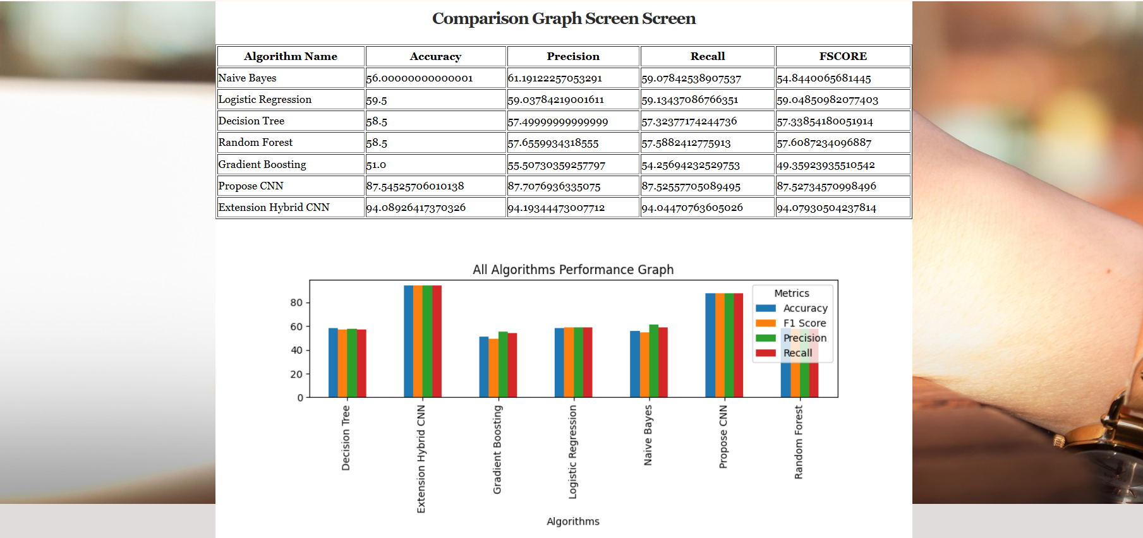
Project Output
Graph Scores of Algorithms

Slide 29
References
[1]. T. Fagni, F. Falchi, M. Gambini, et al., “Tweepfake: About detecting deepfake tweets,” PLOS One, vol. 16, pp. 1–20, Jan. 2021.
[2]. S. Mitrović, D. Andreoletti, and O. Ayoub, “ChatGPT or human? Detect and explain,” arxiv preprint, vol. 2023, pp. 1–10, Jan. 2023.
[3]. R. Vaibhav, R. Furqan, A. Aashir, P. B. Washington, E. Lee, and A. Imran, “Deepfake tweets classification using stacked Bi-LSTM and word embeddings,” PeerJ Comput. Sci., vol. 7, pp. e745, Dec. 2021.
[4]. A. Heidari, N. J. Navimipour, H. Dag, and M. Unal, “Deepfake detection using deep learning methods: A systematic and comprehensive review,” WIRES Data Mining and Knowledge Discovery, vol. 14, no. 2, pp. e1520, Mar. 2024.

Slide 30

Git Hub Dashboard
GitHub link : https://github.com/k-venky/CSD_2021-25_A-15

Slide 31
Any Queries?

Slide 32
Thank You!!!

